Slide 1

AMCAT DATA ANALYSIS
NAME – MAUSUMI MEHER

Slide 2
About me
Education:
I graduated with a Master's degree in Mathematics from Indian Institute of Technology (IIT) Indore in 2022. Throughout my academic journey, I developed strong expertise in Python, SQL, statistics, probability, and machine learning, enabling me to apply quantitative and analytical skills to real-world problems.
Professional Experience:
At Indxx Capital Management Pvt Ltd, I progressed from an Analyst to a Senior Associate, where I work in financial analytics and algorithm development to track key market indicators, driving a 28% increase in quarterly revenue. I customized investment strategies through White Label Indexing Services, tailoring solutions to meet client needs. I also developed robust models using Python, MATLAB, and Excel for daily index value computations, disseminating these across platforms like Bloomberg, Reuters, and Morningstar. This experience has equipped me with strong skills in financial modeling, automation, and data-driven strategy implementation.
LinkedIn ID :
https://www.linkedin.com/in/mausumi-meher-242a73222/

Slide 3
Business Problems:
In today's competitive job market, understanding the key factors that influence the employment outcomes of engineering graduates is critical for both educational institutions and recruiters. The dataset provided by Aspiring Minds Employment Outcome 2015 (AMEO) focuses on engineering graduates and their post-graduation employment metrics such as salary, job titles, and job locations. This dataset contains a wealth of information, including cognitive skills, technical skills, personality traits, and demographic features, with around 40 independent variables and 4000 data points.
Objective:
The business problem is to identify and analyze the key factors that impact the employment outcomes (e.g., salary levels, job titles, and job locations) of engineering graduates. Specifically, the goal is to:
1. Identify the relationship between demographic factors (such as gender and location) and job outcomes.
2. Understand how standardized test scores in these areas correlate with job titles and locations.
3. Help educational institutions understand which skill sets they should emphasize to improve their students' employment outcomes.
By solving this business problem, organizations can optimize their talent acquisition processes, while educational institutions can better align their curriculum with the demands of the job market, ultimately benefiting graduates by enhancing their employability.

Slide 4
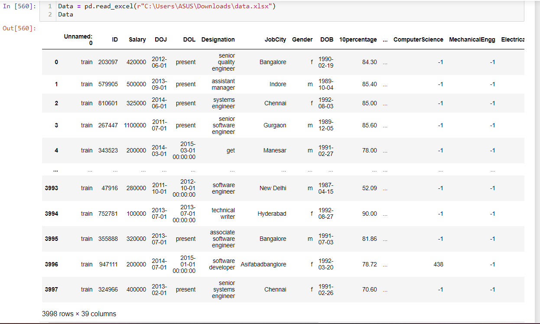
Summary of Datasets
The AMCAT dataset contains 3998 rows and 39 columns, which likely includes information related to the employment outcomes, skill assessments, and demographic details of candidates. The screenshot is attached below:

Slide 5
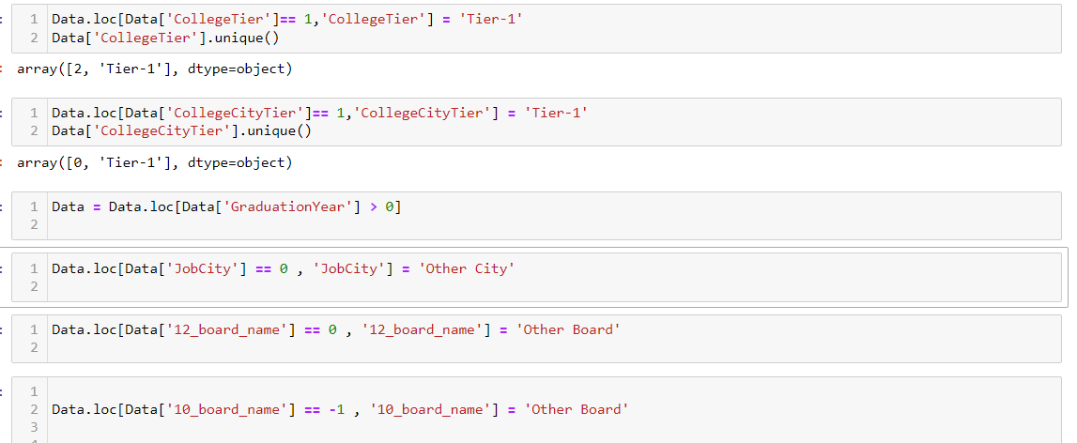
Data Cleaning Step:
The dataset does not contain any null values. We drop an unnecessary column named Id. We have fixed some column names using rename().
Data Manipulation step:
We change the values of some column to better analysis of data.

Slide 6
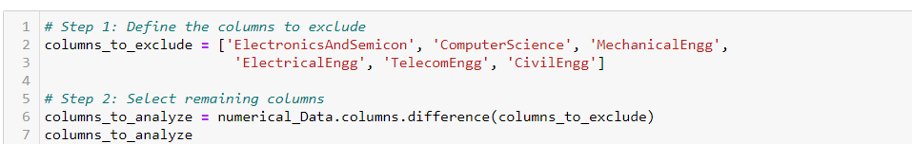
For each numerical feature (col), the function prints the column name, followed by a set of aggregated statistics: minimum (min), maximum (max), mean, median, standard deviation (std), and skewness.
Now we divide both numerical and categorical data in the dataset using select.dtypes().
Again divide numerical features in to 2 parts that due to some columns contain -1 values , that signifies people don’t attempt the exam / course.
Univariate Analysis:
1. Non Visual Analysis:
For each numerical feature (col), the function prints the column name, followed by a set of aggregated statistics: minimum (min), maximum (max), mean, median, standard deviation (std), and skewness. The function is applied to a subset of the dataset columns (e.g., columns_to_analyze, columns_to_exclude).
For each categorical feature (col), the function prints the count of occurrences, unique values, and the number of unique values (nunique). It also prints the value counts for each category in the column, allowing for a clear view of the distribution. The function is applied to the categorical columns (Categorical_Data) in the dataset.

Slide 7
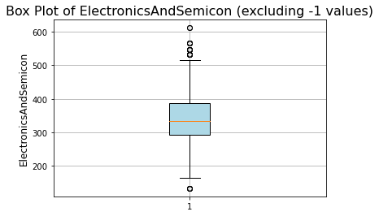
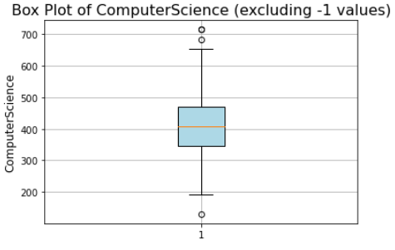
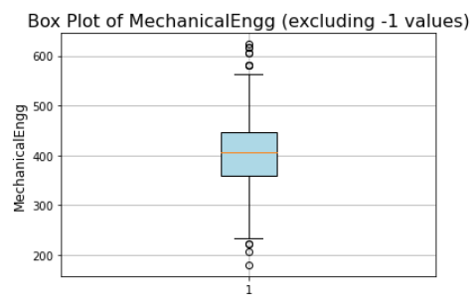
2. Visual Analysis:
In computer science column, the median is around 400, indicating that half of the students have scores above 400 and half have scores below. The IQR (range between Q1 and Q3) shows that most students scored between 350 and 475. Outliers beyond the upper whisker (above 650) and lower whisker (below 250) indicate that there are a few students with much higher or much lower scores compared to the rest.
In ElectronicsAndSemicon column, the median is around 350, indicating that half of the students have scores between 280 and 380. Outliers beyond the upper whisker (above 520) and lower whisker (below 100) indicate that there are a few students with much higher or much lower scores compared to the rest.
In mechanical column, the median is around 400, indicating that half of the students have scores between 350 and 450. Outliers beyond the upper whisker (above 580) and lower whisker (below 250) indicate that there are a few students with much higher or much lower scores compared to the rest.
There are no outliers in other ElectricalEngg, TelecomEngg, CivilEngg columns.

Slide 8
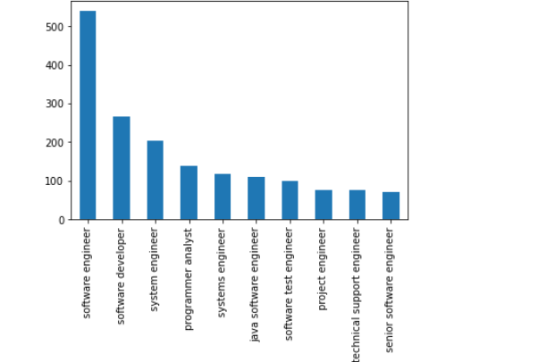
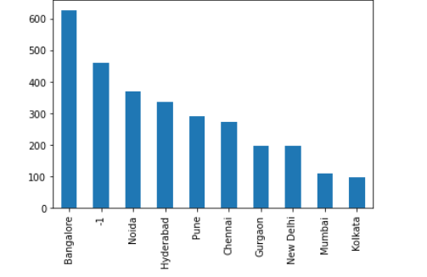
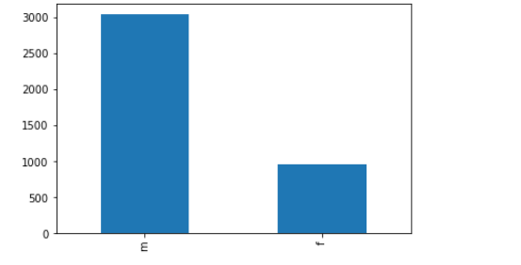
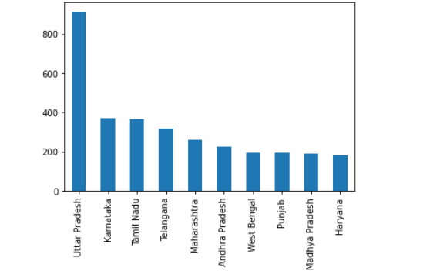
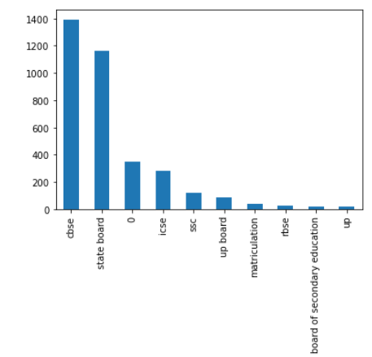
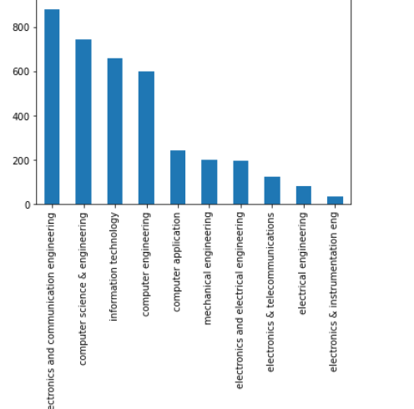
Categorical Univariate Analysis:
Most people got the software engineering jobs at Bangalore after completing the course. In gender analysis, Male ratio is high. Most people transition the board from State board to CBSE after 10th. Electronics and Telecommunication engineer specialization is pursued by most. Most students are from Uttar Pradesh state, followed by Karnataka and Tamilnadu.

Slide 9
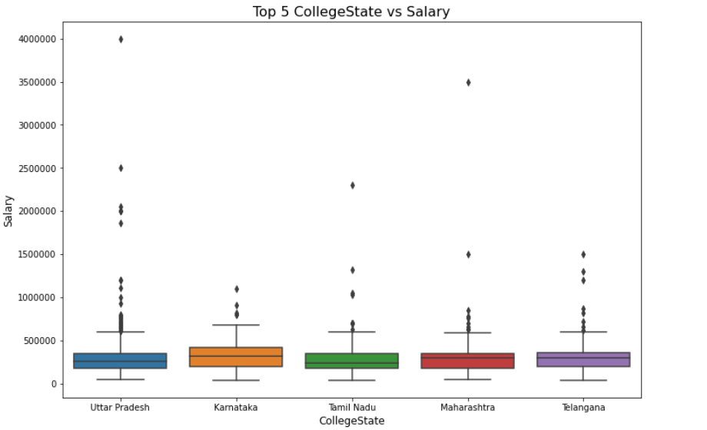
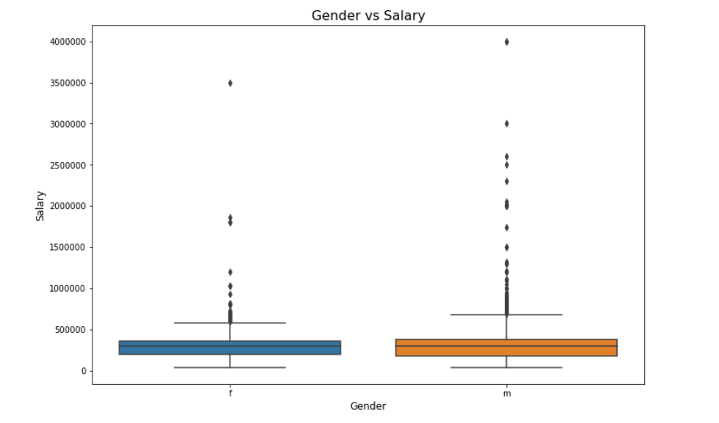
Bivariate Analysis:
We analyse bivariate analysis in 3 different type . We show all the analysis below.
Numerical V/s Categorical:
The candidates whose got more salary package after B.Tech are from Uttar Pradesh followed by Karnataka and Tamil Nadu. Male candidate got higher package than female candidate.

Slide 10
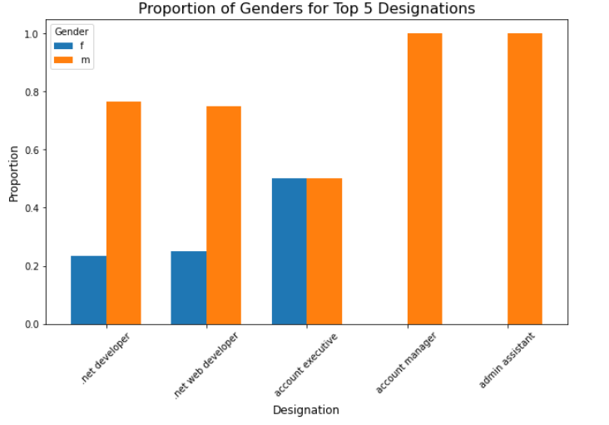
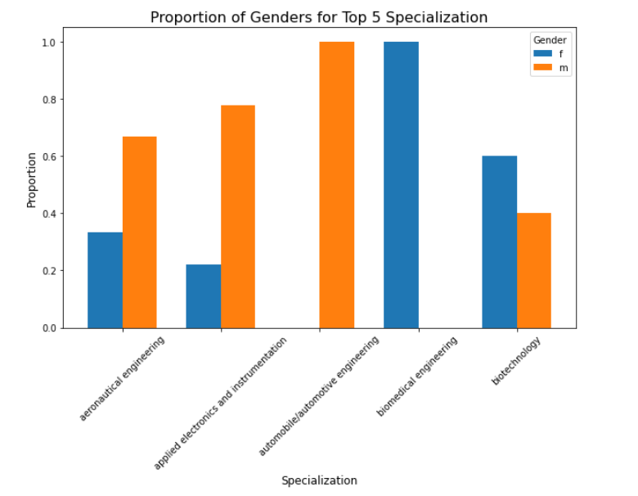
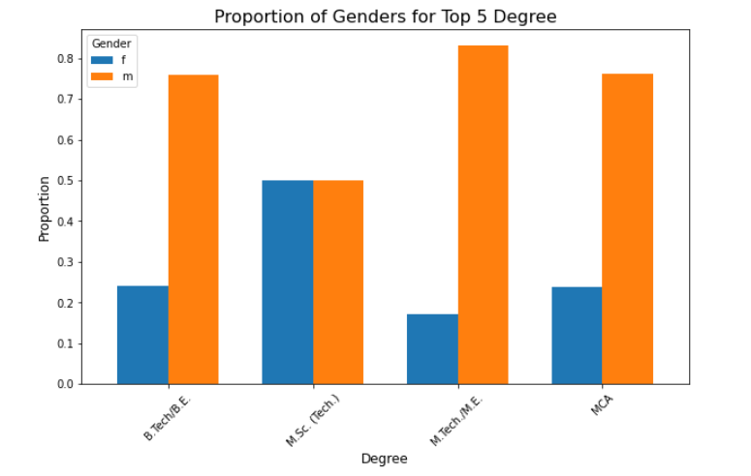
2. Categorical V/s Categorical:
The highest salaried designation is .NET Developer with high male ratio. More person pursued the aeronautical engineering with high male ratio. Many male candidate pursued M.E/ MTech . Both Male and female candidates have same ratio of enrollment in M.Sc. (Tech).
The below stacked bar chart shows that the top 5 values representation of gender V/s Designation, gender V?s Specialization, gender V/S degree.

Slide 11
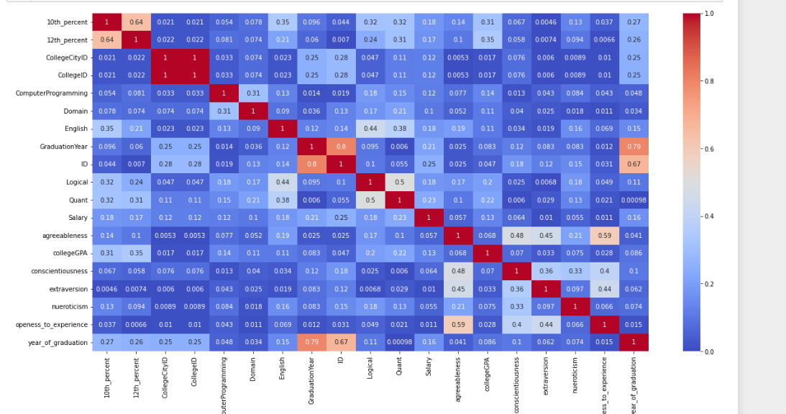
3. Numerical V/s Numerical: The heatmap provided is a correlation matrix that visualizes the relationships between different variables in the dataset. The color intensity represents the strength and direction of the correlation, with darker shades of red indicating stronger positive correlations (close to +1) and darker shades of blue indicating stronger negative correlations (close to -1). Key observations:
1. Strong Positive Correlations:
"CollegeID" and "CollegeCityID" also show a high correlation (1), indicating these variables might be interrelated or contain redundant information.
2. Moderate Correlations:
"12th_percent" and "10th_percent" have a moderate correlation of 0.64, which makes sense as performance in one school level is somewhat predictive of performance in another.
"Logical" and "Quant" (0.5) show a good correlation, indicating that logical reasoning and quantitative skills might be related.
3. Low to No Correlation:
Many personality traits like "Agreeableness," "Openness_to_experience," and "Conscientiousness" have weak correlations with other academic and skill-based variables, indicating these traits are likely independent of academic performance.

Slide 12
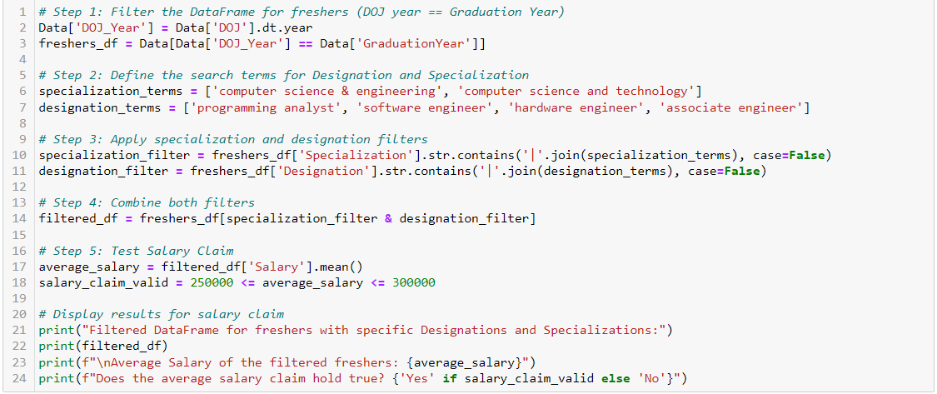
Key Business questions:
Times of India article dated Jan 18, 2019 states that “After doing your Computer Science Engineering if you take up jobs as a Programming Analyst, Software Engineer, Hardware Engineer and Associate Engineer you can earn up to 2.5-3 lakhs as a fresh graduate.” Test this claim with the data given to you.
Answer: The Average Salary of the freshers is 340161.29032258067.

Slide 13
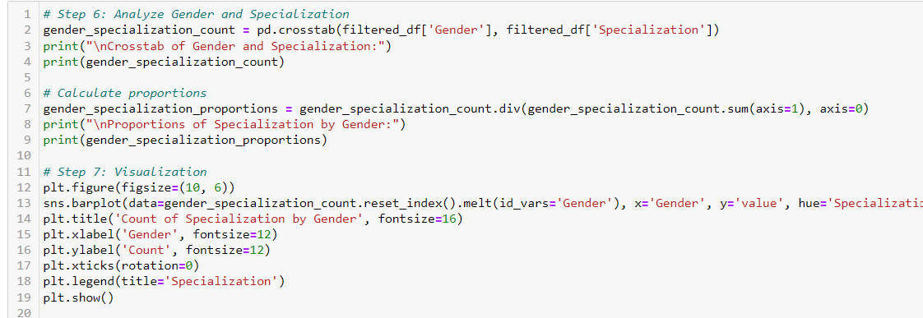
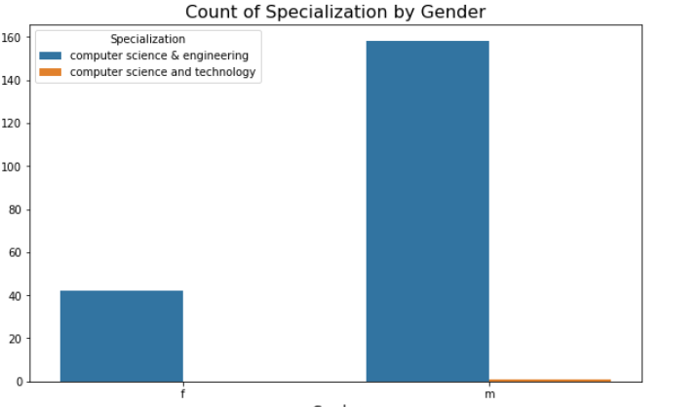
2. Is there a relationship between gender and specialization? (i.e. Does the preference of Specialization depend on the Gender?)
Answer:
The data presents a gender distribution in two specializations: "Computer Science & Engineering" and "Computer Science and Technology." For "Computer Science & Engineering," there are 42 females and 158 males, while for "Computer Science and Technology," there is 1 male and no females. The proportions show that females account for 1% and males 99.37% in "Computer Science & Engineering," whereas "Computer Science and Technology" is exclusively male with no female representation. This indicates a significant gender disparity in these engineering specializations.

Slide 14

THANK YOU

